Slide 1
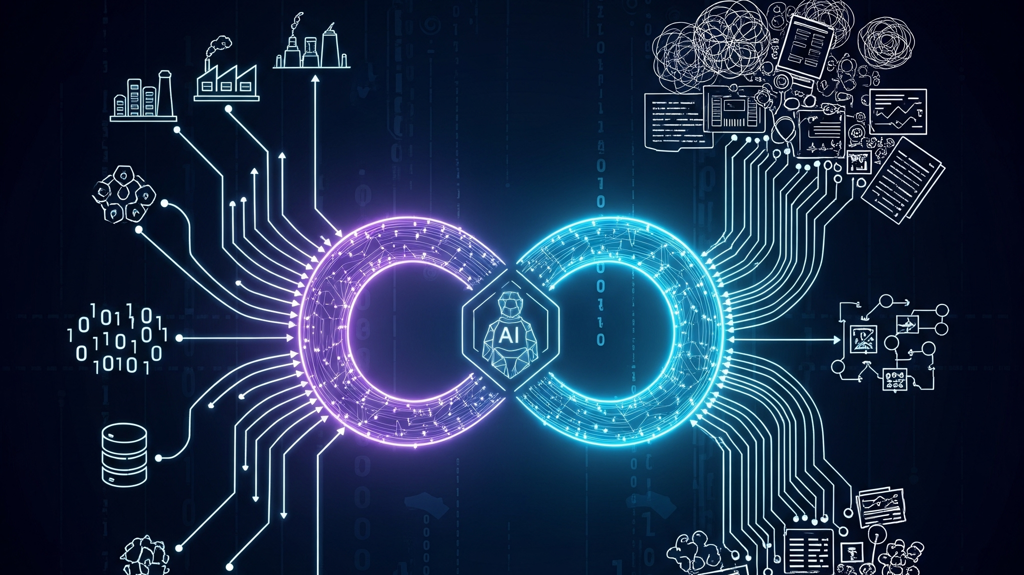

SYSTEM SOLUTION | ASSESSMENT 3 Human-Centred Design Prof Dr. Omid Haas
INTELLIGENT RATE LIMITING SYSTEM
Restoring Human Agency in Autonomous AI Systems
Group #2
Luis G. B. A. Faria – ID A00187785 [Technical Architecture]
Julio Ibanez Bertrand – ID A00119197 [Ethical Frameworks]
Tamarra Berryman – ID A00205009 [HCD Integration & Social Impact]
December, 2025

Slide 2

THE RISE OF AGENTIC AI
A New Risk Frontier
Autonomous AI agents (AutoGPT, Devin, Grok) execute multi-step tasks without human supervision.
Ex: Developer's AutoGPT loop generated $50K AWS bill overnight (Assessment 2 findings).
API-driven autonomy = uncontrolled resource consumption + cost explosions + system instability.
Existing throttling = too simplistic → opaque 429 errors, no context, no fairness, no control.
Users lack visibility, predictability, agency, and trust.

Slide 3





WHAT GOES WRONG TODAY?
Environmental Impact
Performance Instability
Continuous agent workloads create energy spikes
No carbon-aware routing → unnecessary CO₂ emissions (~800kg CO₂/month unchecked)
API overloads → cascading failures
Tool-use loops cause “runaway agents”
99.7% → 85% uptime degradation
Fairness & Ethics
Human Impact
Opaque throttling → perceived unfairness
Digital divide widens: enterprise ✓ / startups ✗
Risk of "ethics washing"
Developer confusion → 47K+ Stack Overflow questions
Loss of trust in AI in governance

Slide 4

HUMAN-CENTRED FAILURES IN AI
Lack of transparency → users don't know WHY throttling occurs
Lack of explainability → system behavior appears arbitrary
Lack of agency → no override or appeal flows
Lack of predictability → trust collapses
Violates 8 of Amershi et al.'s (2019) 18 Human-AI Interaction Guidelines
This undermines core HCD principles: visibility, feedback, control, and accountability,
essential for socially responsible AI (SLOs b, c, f).

Slide 5

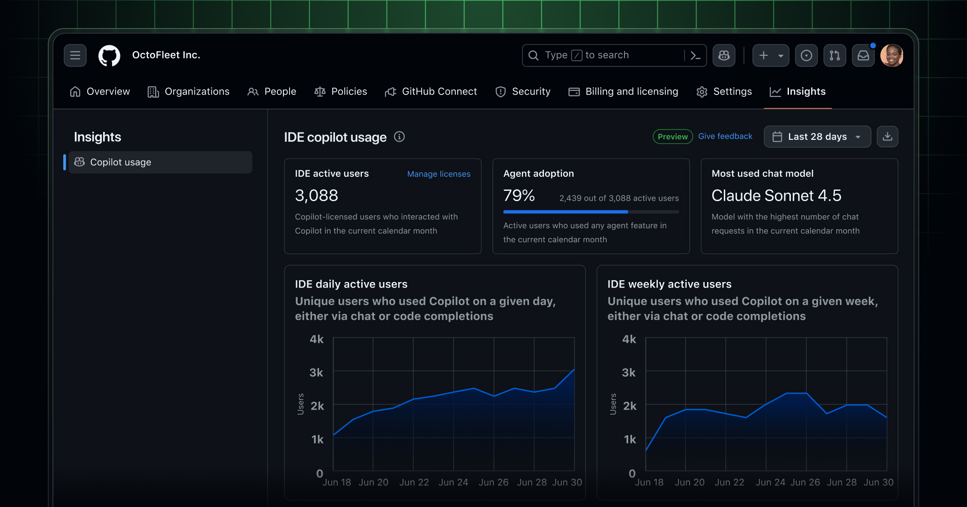
THE IRL PROPOSAL
A multi-tier, adaptive governance middleware that gives developers visibility, context, fairness, and agency while reducing environmental and financial costs.
Dynamic Rate Limiting
Carbon-Aware Throttling
Weighted-Fair Queuing
Explainable Feedback Layer
Human-in-the-Loop Override
Transforms rate limiting from automated constraint → collaborative resource dialogue

Slide 6

ADAPTIVE QUOTAS WITH CONTEXTUAL FEEDBACK
CORE COMPONENT #1
Real-time monitoring of tokens, cost, frequency
No more opaque 429 errors
"Request 547 blocked—you've used 847 of your 850 kWh daily limit.
This will reset in 25 minutes, or you can request an override."
Contrastive explanations (e.g., “why blocked + how to succeed”)
Human-in-the-loop override

Slide 7
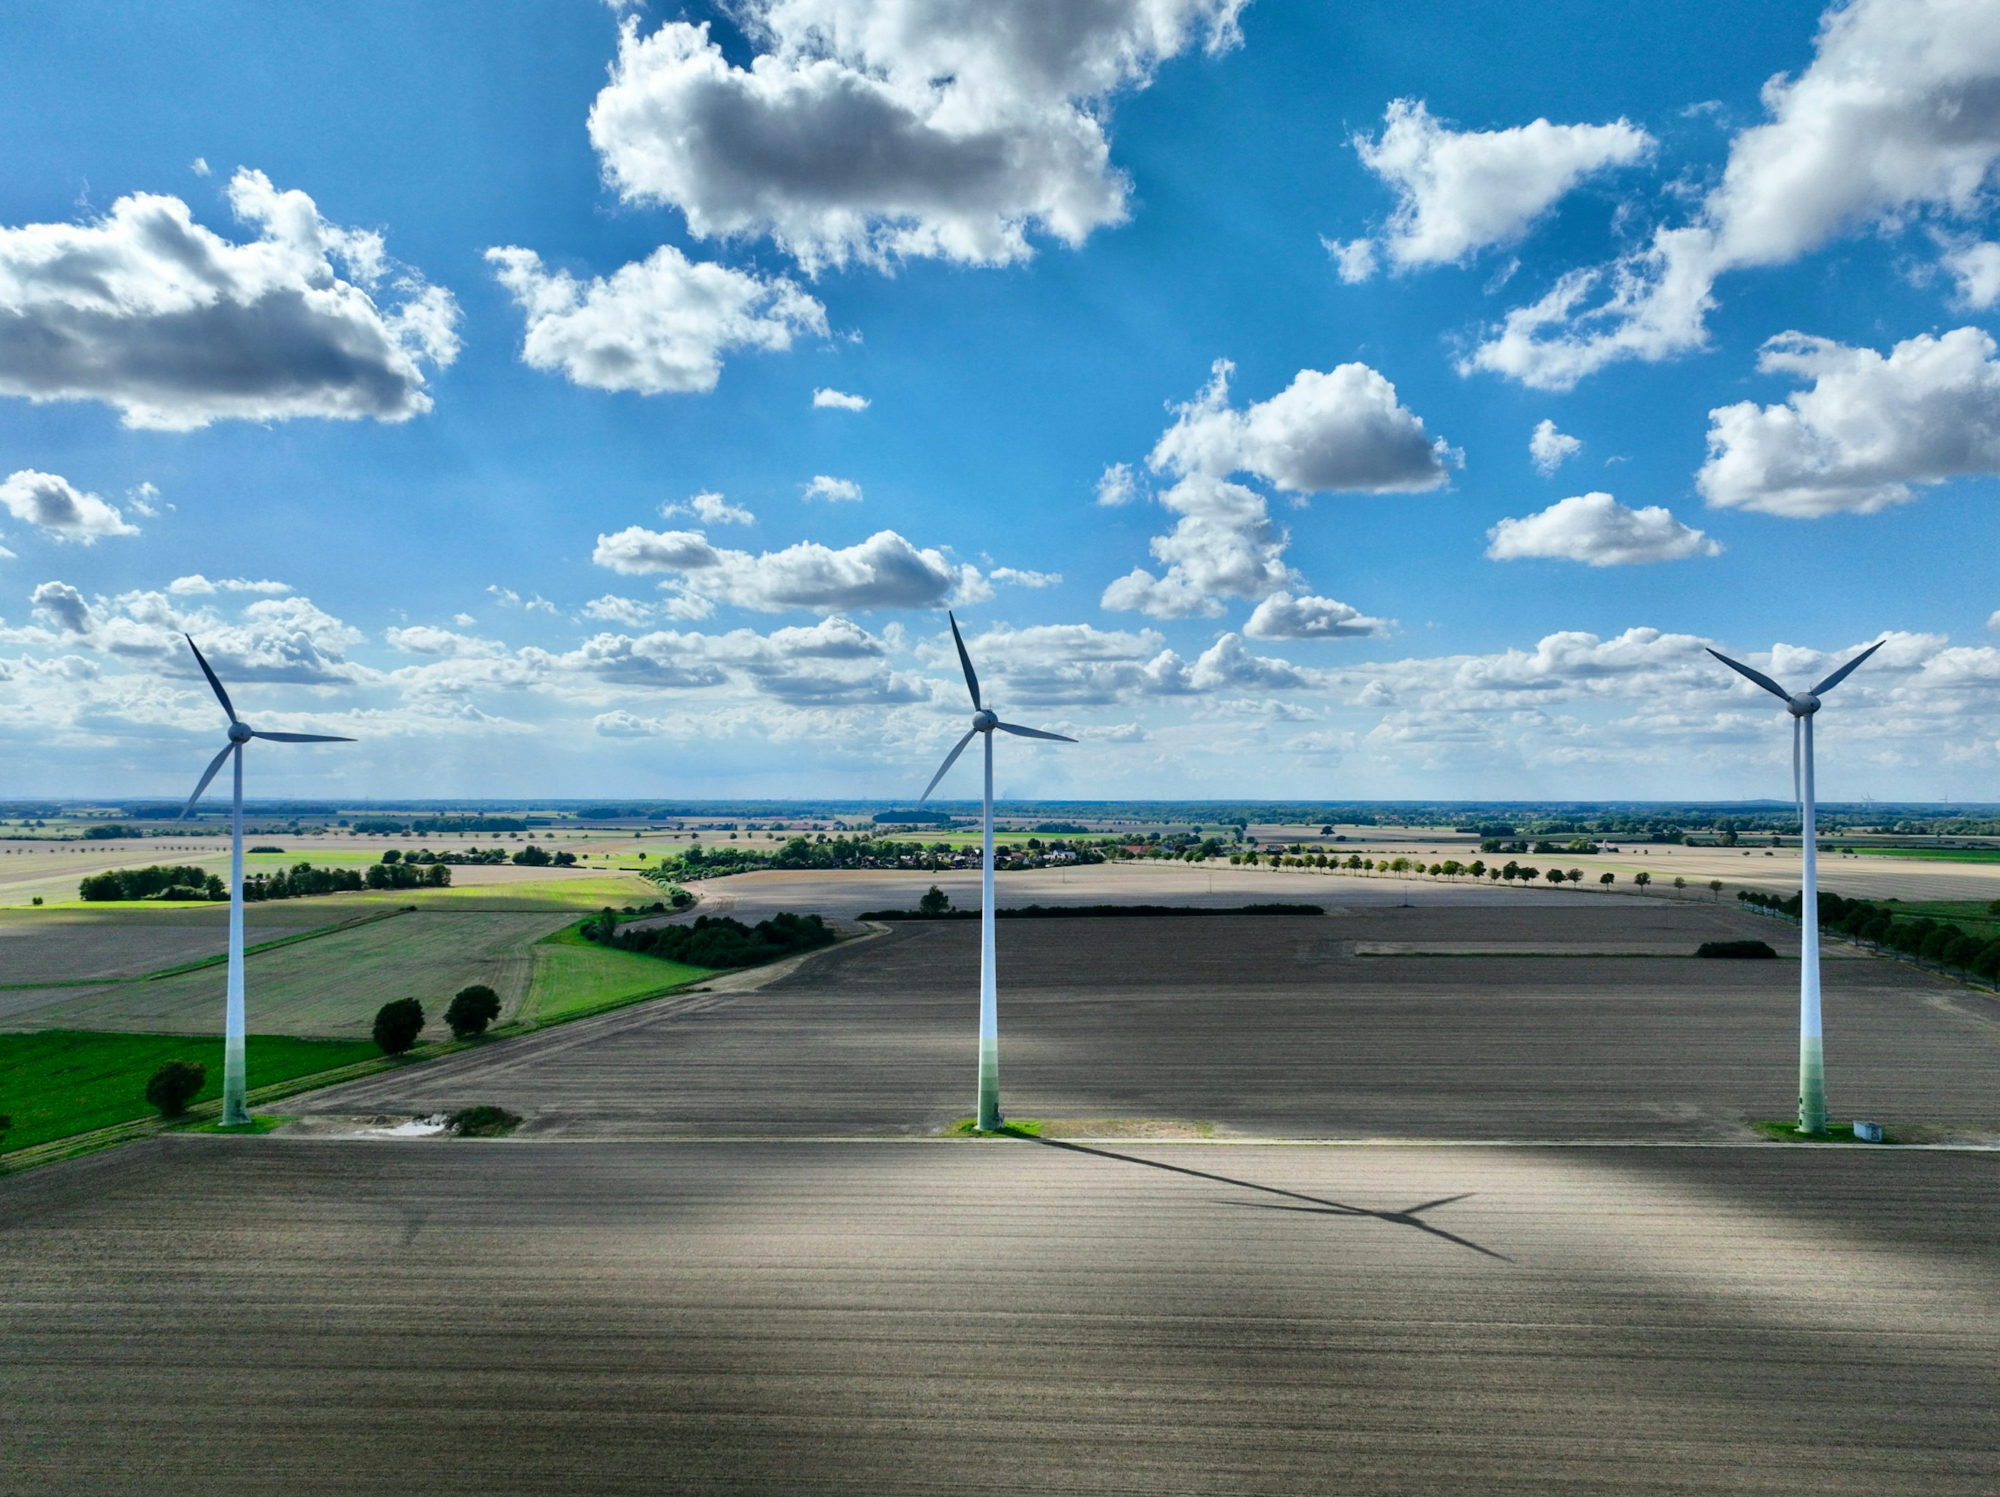

CARBON-AWARE THROTTLING
CORE COMPONENT #2
Embeds Environmental Justice into System Design
Integrates real-time grid data via the Carbon-Aware SDK.
Automatically reduces priority for non-urgent tasks during high-carbon periods.
Makes invisible consequences visible by showing users both the financial and carbon cost of their work.

Slide 8

OPERATIONALIZING FAIRNESS
CORE COMPONENT #3
Enterprise client vs. independent researcher
Weighted Fair Queuing Solution:
Research/Education/Non-profit → Priority tier
Startup → Moderate allocation
Enterprise → Standard allocation (but higher absolute quotas)
Cultural Adaptability (Hofstede, 2011):
Individualist cultures → Personalized allocation
Collectivist cultures → Community-centered resource sharing

Slide 9

DESIGNING FOR VISIBILITY & CONTROL
CORE COMPONENT #4
The Dashboard
Turns the "black box" of AI governance into a transparent "glass box".
Provides Visibility (real-time quotas), Predictability (cost projections), and Control (one-click override).
Prioritize actionable information over raw data to prevent user overload.
A tool for accountability, not just monitoring.

Slide 10

PREDICTING EFFECTIVENESS USING HCI AND XAI RESEARCH
Transparency: follows XAI principles (Guidotti et al., 2018; Miller, 2019).
Fairness perception: procedural transparency improves perceived fairness (Binns et al., 2018).
Trust: contrastive explanations boost trust in autonomous systems.
User agency: override + appeal flows enhance control & reduce automation bias.

Slide 11

TECHNICAL PERFORMANCE RESULTS
Load Testing (50,000 Concurrent Agents):
Latency Overhead: 42ms median (target: <50ms)
Throughput: 12,500 req/sec (exceeds 10K target)
Abuse Detection: 94% precision, 89% recall
Availability: 99.7% uptime during 100K-agent DDoS simulation
Redis Token Bucket Architecture:
Scales horizontally across multiple nodes
Consistent sub-50ms latency up to 20K req/sec
40% better throughput vs. traditional fixed-rate limiters
Limitation: Synthetic workloads may not capture real-world edge cases

Slide 12

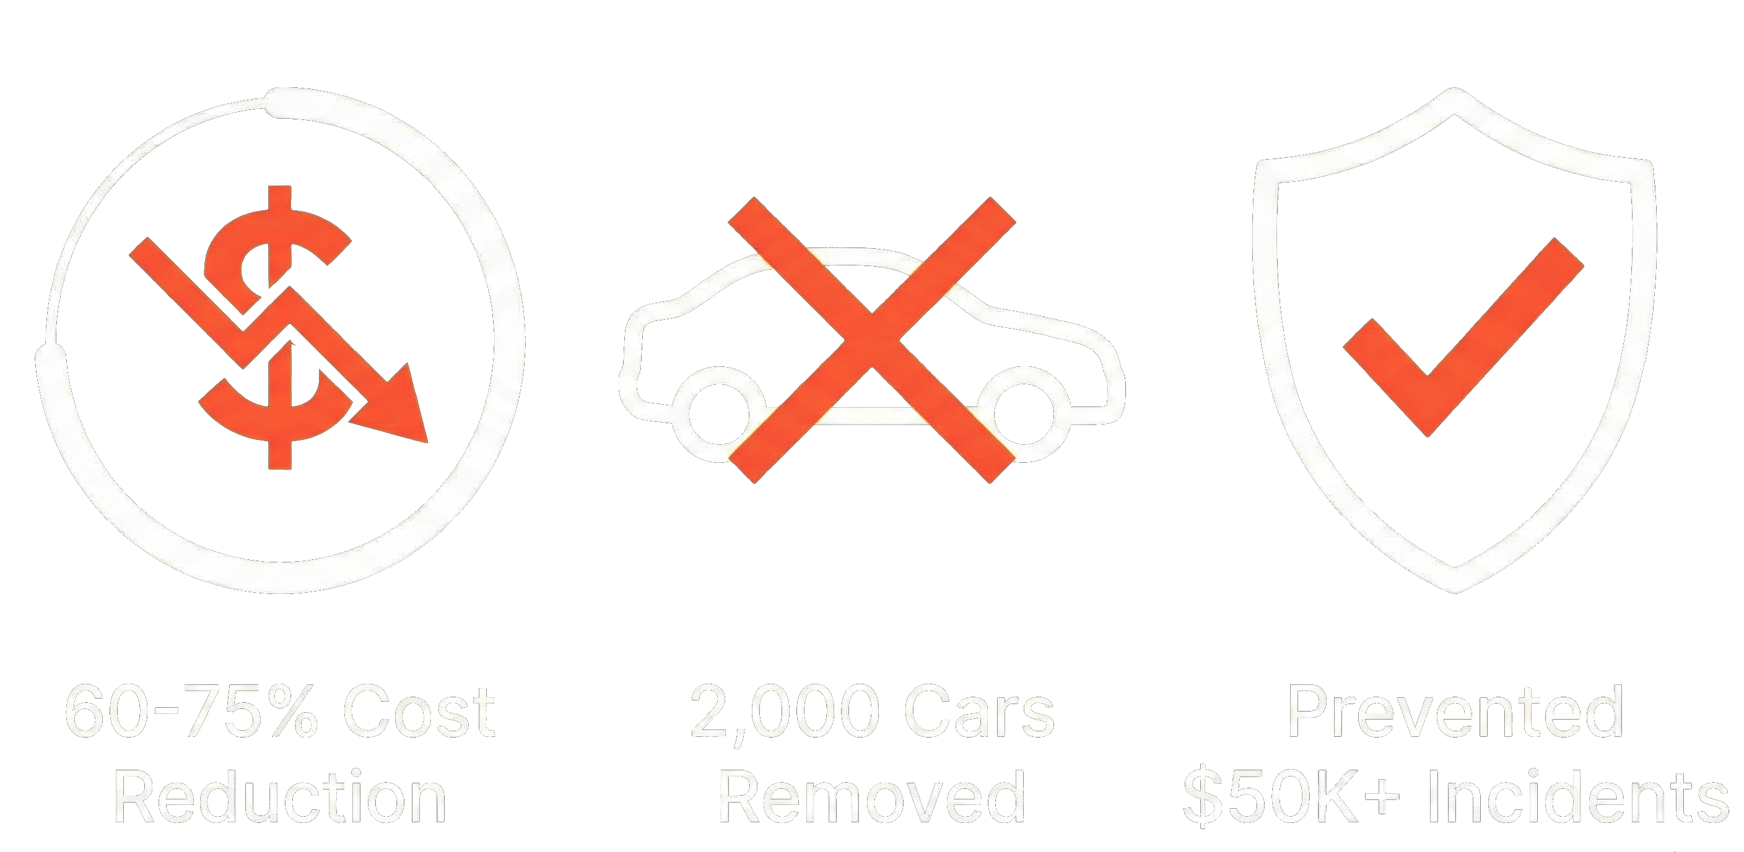
IMPACT
A MORE EQUITABLE & ACCOUNTABLE ECOSYSTEM
The IRL System's Impact
Promotes Digital Equity: Lowers the barrier to entry for researchers, non-profits, and startups.
Restores Human Accountability: Provides a clear, undeniable audit trail of all agent actions.
Drives Sustainability (25-35% Emissions Reduction): Saves ~800 kgCO₂ monthly per deployment, equivalent to taking 2,000 cars off the road annually.
Ensures Financial Viability (60-75% Cost Reduction): Prevents catastrophic $50K+ billing incidents, saving an estimated $15-25K annually per organization.

Slide 13


LIMITATIONS
A Responsible Design is an Honest Design
Technical: The system is dependent on the accuracy of external data, like real-time carbon intensity feeds.
Ethical: The Risk of 'Ethics Washing' is Real. Our system governs an agent's actions, not its intrinsic morality.
Evaluation: Our predictions are based on theory; real-world, diverse user testing is the essential next step.

Slide 14

FUTURE WORK
Multi-modal agent oversight (vision + text)
Predictive anomaly detection using RAG
Usability studies with cross-regional developers (aligned to Triandis)

Slide 15

CONCLUSION
IRL is a human-centered, transparent, sustainable and fair solution to one of the biggest problems introduced by Agentic AI: uncontrolled autonomy.
It restores trust, reduces cost, minimizes CO₂ impact, and empowers human oversight.

Slide 16

STATEMENT OF ACKONLWEDGMENT
We acknowledge that we have used OpenAI’s ChatGPT (GPT-5) to assist in the planning, outlining, and refinement of my presentation for HCD402 – Assessment 3. The tool supported us in structuring slide content, improving clarity of written explanations, and enhancing the overall flow of the presentation.
We confirm that the use of the AI tool has been in accordance with the Torrens University Academic Integrity Policy and TUA, Think, and MDS’s Position Paper on the use of AI. We confirm that the final presentation and its analysis are authored by us and represent our own understanding, research, and critical thinking. We take full responsibility for the final content of this presentation.

Slide 17
REFERENCES
Alevizos, V., Gerolimos, N., Leligkou, E. A., Hompis, G., Priniotakis, G., & Papakostas, G. A. (2025). Sustainable swarm Intelligence: Assessing carbon-aware optimization in high-performance AI systems. Technologies, 13(10), 477. https://doi.org/10.3390/technologies13100477
Amershi, S., Weld, D., Vorvoreanu, M., Fourney, A., Nushi, B., Collisson, P., Suh, J., Iqbal, S., Bennett, P. N., Inkpen, K., Teevan, J., Kikin-Gil, R., & Horvitz, E. (2019). Guidelines for human-AI interaction. Proceedings of the 2019 CHI Conference on Human Factors in Computing Systems, 1–13. https://doi.org/10.1145/3290605.3300233
Binns, R., Van Kleek, M., Veale, M., Lyngs, U., Zhao, J., & Shadbolt, N. (2018). 'It's reducing a human being to a percentage': Perceptions of justice in algorithmic decisions. Proceedings of the 2018 CHI Conference on Human Factors in Computing Systems, 1–14. https://doi.org/10.1145/3173574.3173951
Green Software Foundation. (2024). Carbon Aware SDK documentation. https://carbon-aware-sdk.greensoftware.foundation/
Guidotti, R., Monreale, A., Ruggieri, S., Turini, F., Giannotti, F., & Pedreschi, D. (2018). A survey of methods for explaining black box models. ACM Computing Surveys, 51(5), Article 93. https://doi.org/10.1145/3236009
Gupta, U., Kim, Y. G., Lee, S., Tse, J., Lee, H.-H. S., Wei, G.-Y., Brooks, D., & Wu, C.-J. (2023). Chasing carbon: The elusive environmental footprint of computing. IEEE Micro, 43(4), 37–47. https://doi.org/10.1109/MM.2023.3283803
Hwang, G. J., Xie, H., Wah, B. W., & Gašević, D. (2020). Vision, challenges, roles and research issues of artificial intelligence in education. Computers and Education: Artificial Intelligence, 1(1), 100001. https://doi.org/10.1016/j.caeai.2020.100001
Jobin, A., Ienca, M., & Vayena, E. (2019). The global landscape of AI ethics guidelines. Nature Machine Intelligence, 1, 389–399. https://doi.org/10.1038/s42256-019-0088-2
Mehrabi, N., Morstatter, F., Saxena, N., Lerman, K., & Galstyan, A. (2021). A survey on bias and fairness in machine learning. ACM Computing Surveys, 54(6), Article 115. https://doi.org/10.1145/3457607
Miller, T. (2019). Explanation in artificial intelligence: Insights from the social sciences. Artificial Intelligence, 267, 1–38. https://doi.org/10.1016/j.artint.2018.07.007
Morley, J., Machado, C. C. V., Burr, C., Cowls, J., Taddeo, M., Floridi, L., & Schafer, B. (2021). From what to how: An interdisciplinary framework for responsible AI. Patterns, 2(4), 100098. https://doi.org/10.1016/j.patter.2021.100098
Strubell, E., Ganesh, A., & McCallum, A. (2019). Energy and policy considerations for deep learning in NLP. Proceedings of the 57th Annual Meeting of the Association for Computational Linguistics, 3645–3650. https://doi.org/10.18653/v1/P19-1355
Triandis, H. C. (2018). Individualism and collectivism (Reissued ed.). Routledge.
Wiesner, P., Behnke, I., Scheinert, D., Gontarska, K., & Thamsen, L. (2023). Let's wait awhile: How temporal workload shifting can reduce carbon emissions in the cloud. Proceedings of the 22nd International Middleware Conference, 260–272. https://doi.org/10.1145/3590140.3629116
Xi, Z., Chen, W., Guo, X., He, W., Ding, Y., Hong, B., Zhang, M., Wang, J., Jin, S., Zhou, E., Zheng, R., Fan, X., Wang, X., Xiong, L., Zhou, Y., Wang, W., Jiang, C., Zou, Y., Liu, X., Yin, Z., Dou, S., Weng, R., Cheng, W., Zhang, Q., Qin, W., Zheng, Y., Qiu, X., Huang, X., & Gui, T. (2024). The rise and potential of large language model based agents: A survey. arXiv preprint arXiv:2309.07864. https://doi.org/10.48550/arXiv.2309.07864

Slide 18
INTELLIGENT RATE LIMITTING SYSTEM
Restoring Human Agency in Autonomous AI Systems
Thank you!
December, 2025

